Slide 1
Quality Assurance(QA)? Process, Methods, Examples
Lecture 3

Slide 2
What is Quality?
Quality is extremely hard to define,
and it is simply stated: "Fit for use or purpose."
It is all about meeting the needs and expectations of customers with respect to functionality, design, reliability, durability, & price of the product.
Notes:
software durability means the solution ability of serviceability of software and to meet user's needs for a relatively long time.

Slide 3
What is Assurance?
Assurance is nothing but a positive declaration on a product or service, which gives confidence.
It is certainty of a product or a service, which it will work well.
It provides a guarantee that the product will work without any problems as per the expectations or requirements.

Slide 4
What is Quality Assurance?
Quality Assurance (QA) is defined as an activity to ensure that an organization is providing the best possible product or service to customers.
QA focuses on improving the processes to deliver Quality Products to the customer.
An organization has to ensure, that processes are efficient and effective as per the quality standards defined for software products.

Slide 5
What is Quality Control?
Quality control popularly abbreviated as QC.
It is a Software Engineering process used to ensure quality in a product or a service.
It does not deal with the processes used to create a product; rather it examines the quality of the "end products" and the final outcome.
QC also evaluates people on their quality level skill sets and imparts training and certifications.
This evaluation is required for the service based organization and helps provide "perfect" service to the customers.

Slide 6
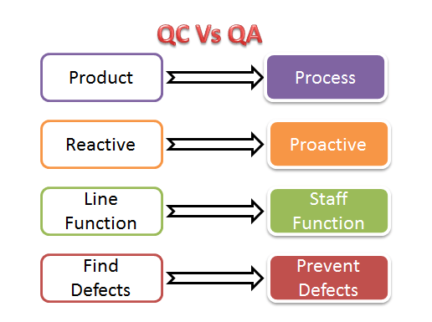
Quality Control vs Quality Assurance?

Slide 7
Examples of QC and QA activities are as follows:
Quality Control Activities | Quality Assurance Activities
Walkthrough | Quality Audit
Testing | Defining Process
Inspection | Tool Identification and selection
Checkpoint review | Training of Quality Standards and Processes

Slide 8
SQA and QC
The above activities are concerned with QA and QC of any product and not essentially software. With respect to software
QA becomes SQA ( Software Quality Assurance)
QC becomes Software Testing.

Slide 9
SQA | Software Testing
Software Quality Assurance is about engineering process that ensures quality | Software Testing is to test a product for problems before the product goes live
Involves activities related to the implementation of processes, procedures, and standards. Example - Audits Training | Involves actives concerning verification of product Example - Review Testing
Process focused | Product focused
Preventive technique | Corrective technique
Proactive measure | Reactive measure
The scope of SQA applied to all products that will be created by the organization | The scope of Software Testing applies to a particular product being tested.

Slide 10
Quality Assurance Functions
There are 5 primary Quality Assurance Functions:
Technology transfer: This function involves getting a product design document as well as trial and error data and its evaluation. The documents are distributed, checked and approved.
Validation: Here validation master plan for the entire system is prepared. Approval of test criteria for validating product and process is set. Resource planning for execution of a validation plan is done.

Slide 11
Quality Assurance Functions cont..
Documentation: This function controls the distribution and archiving of documents. Any change in a document is made by adopting the proper change control procedure. Approval of all types of documents.
Assuring Quality of products: Assure that the product is of required quality.
Quality improvement plans: Plan to improve quality

Slide 12
Quality Assurance Certifications:
There are several certifications available in the industry to ensure that Organizations follow Standards Quality Processes.
ISO 9000
This standard was first established in 1987
It is related to Quality Management Systems. This helps the organization ensure quality to their customers and other stakeholders.
An organization who wishes to be certified as ISO 9000 is audited based on their functions, products, services and their processes.

Slide 13
ISO 9000 Benefits
This certification helps –
Increase the profit of the organization
Improves Domestic and International trade
Reduces waste and increase the productivity of the employees
Provide Excellent customer satisfaction
They are not specific to any one industry and can be applied to organizations of any size.

Slide 14
CMMI level
The Capability Maturity Model Integrated (CMMI) is a process improvement approach developed specially for software process improvement.
It is based on the process maturity framework and used as a general aid in business processes in the Software Industry.
This model is highly regarded and widely used in Software Development Organizations.

Slide 15
CMMI Level
CMMI has 5 levels. An organization is certified at CMMI level 1 to 5 based on the maturity of their Quality Assurance Mechanisms.
Level 1 - Initial: In this stage the quality environment is unstable. Simply, no processes have been followed or documented
Level 2 - Repeatable: Some processes are followed which are repeatable. This level ensures processes are followed at the project level.
Level 3 - Defined: Set of processes are defined and documented at the organizational level. Those defined processes are subject to some degree of improvement.
Level 4 - Managed: This level uses process metrics and effectively controls the processes that are followed.
Level 5 - Optimizing: This level focuses on the continuous improvements of the processes through learning & innovation.

Slide 16
Test Maturity Model (TMM):
This model assesses the maturity of processes in a Testing Environment. Even this model has 5 levels, defined below-
Level 1 - Initial: There is no quality standard followed for testing processes and only ad-hoc methods are used at this level
Level 2 - Definition: Defined process. Preparation of test strategy, plans, test cases are done.
Level 3 - Integration: Testing is carried out throughout the software development lifecycle (SDLC) - which is nothing but integration with the development activities, E.g., V- Model.
Level 4 - Management and Measurement: Review of requirements and designs takes place at this level and criteria has been set for each level of testing
Level 5 - Optimization: Many preventive techniques are used for testing processes, and tool support(Automation) is used to improve the testing standards and processes.

